Slide 1
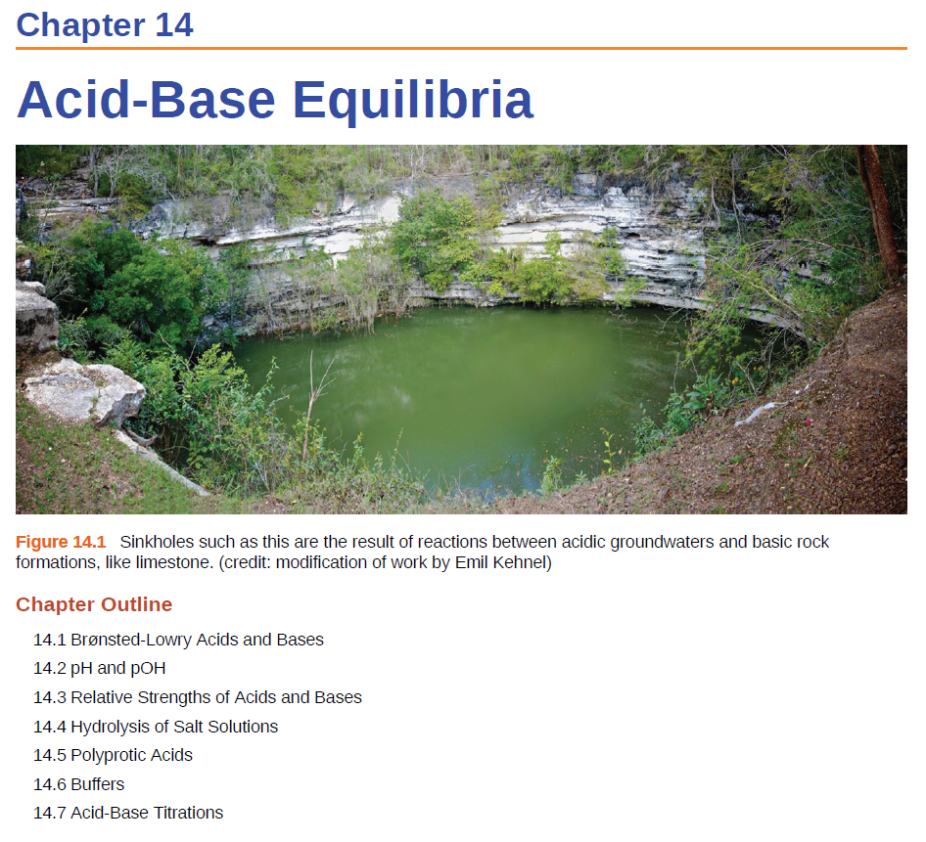
CH 4, Review

Slide 2
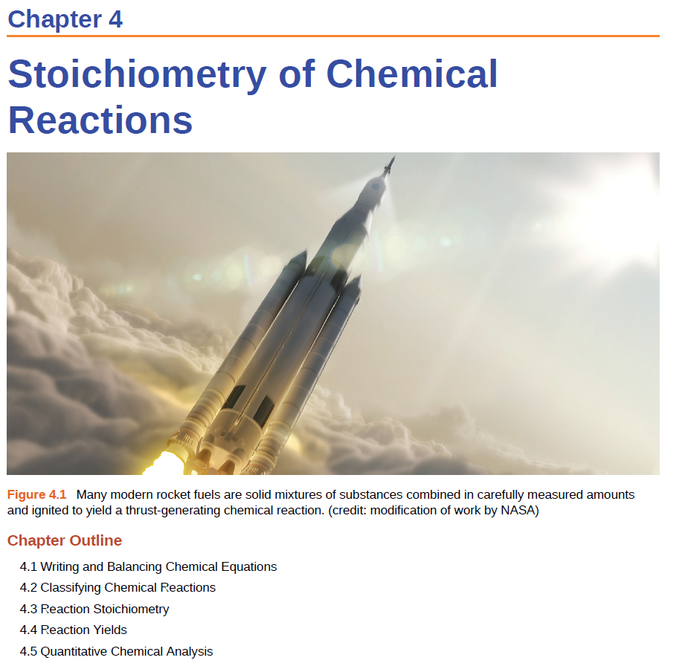


Slide 3
Acids and Bases: Arrhenius Definition
An acid is a substance that dissociates in water to yield H₃O⁺.
A base is a substance that dissociates in water to yield OH–.
This explains why all neutralization reactions between strong acids and bases and have similar heats of reaction:
H⁺(aq) + OH–(aq) → H₂O(l) ΔH⁰ = -57 kJ/mol

Slide 4
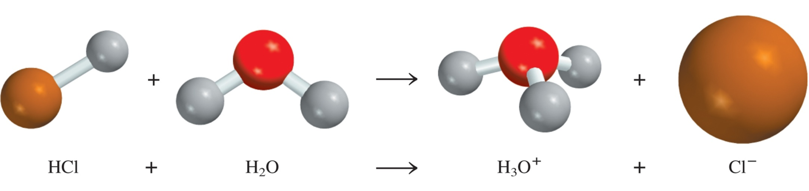
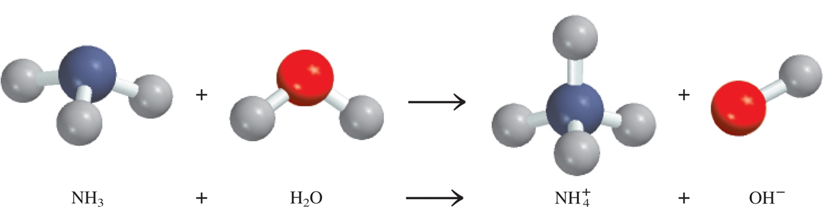
Acids and Bases: Arrhenius Definition
Arrhenius acid is a substance that produces H⁺ (H₃O⁺) in water.
Arrhenius base is a substance that produces OH⁻ in water.
Can something be an acid/base if its not soluble in water?
Brønsted and Lowry proposed a more general definition…

Slide 5
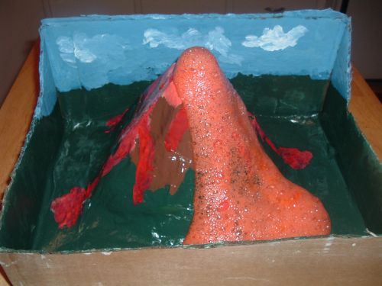
Brønsted Acids
Bronsted Acids- able to donate a proton in the form of hydrogen ions – protons – H⁺.
AH A⁻ + H⁺
Typically :
have a sour taste (vinegar-acetic acid, lemons-citric acid)
change the color of litmus from blue to red.
react with carbonates to produce CO₂.
H₃CCOOH_{(aq)} + NaHCO_{3(s)} NaOOCCH_{3(aq)} + CO_{2(g)} + H₂O_{(l)}

Slide 6
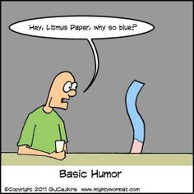
Brønsted Bases
Bronsted Base- able to accept a proton in the form of hydrogen ions – protons – H⁺.
B⁻ + H⁺ BH
Typically :
have a lone pair of electrons.
have a bitter taste (antacids-Mg(OH₂)).
change the color of litmus from red to blue.
feel slippery (turns your cells and fat into soap!).

Slide 7
Brønsted Acid/Base
Bronsted Acids- able to donate a proton in the form of hydrogen ions – protons – H⁺.
AH A⁻ + H⁺
Bronsted Base- able to accept a proton in the form of hydrogen ions – protons – H⁺. Typically has a lone pair.
B⁻ + H⁺ BH

Slide 8
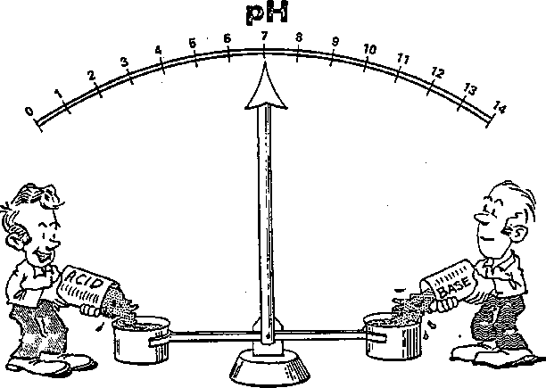
Acid-Base Neutralization
acid + base salt + water
HCl (aq) + NaOH (aq) NaCl (aq) + H₂O
H⁺ + Cl⁻ + Na⁺ + OH⁻ Na⁺ + Cl⁻ + H₂O
H⁺ + OH⁻ H₂O

Slide 9
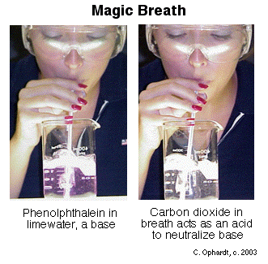
Acid-Base Neutralization
acid + base salt + water + CO₂
2HCl (aq) + Na₂CO₃ (aq) 2NaCl (aq) + H₂O +CO₂
2H⁺ + 2Cl⁻ + 2Na⁺ + CO₃²⁻ 2Na⁺ + 2Cl⁻ + H₂O + CO₂
2H⁺ + CO₃²⁻ H₂O + CO₂

Slide 10
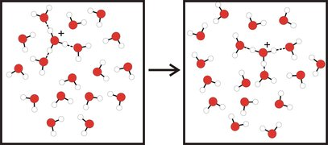
Note on: Acids in Water
A strong acid like HCl will dissociate:
HCl → Cl⁻ + H⁺
H⁺ does not freely exist in water.
In water:
hydronium ion ≈ hydrogen ion
H₃O⁺ ≈ H⁺
[H⁺] is often used as an abbreviation for [H₃O⁺]. However, H+ does not exist in water.

Slide 11
Hydronium Ion
AH A⁻ + H⁺
Chemical Reality:
HCl + H₂O → Cl⁻ + H₃O⁺
Chemical Bookkeeping:
HCl → Cl⁻ + H⁺
H₃O⁺ ≈ H⁺

Slide 12
CH 4, Review

Slide 13
Bronsted Acid and Base
Bronsted Acids- able to donate protons in the form of hydrogen ions – protons – H⁺.
AH A⁻ + H⁺
HCl → Cl⁻ + H⁺
C₂H₃O₂H → C₂H₃O₂⁻ + H⁺
Bronsted Base- able to accept protons in the form of hydrogen ions or H⁺.
B⁻ + H⁺ BH
NH₃ + H⁺ → NH₄⁺
HO⁻ + H⁺ → H₂O

Slide 14
Conjugate Acid-Base Pairs
Consider the ionization of HCl:
HCl_{(g)} + H₂O_{(l)} ⎯→ Cl–_{(aq)} + H₃O⁺_{(aq)}
  HCl donates a proton, thus it is an acid.
  H₂O accepts a proton and is a base.
Now, consider the reverse reaction:
HCl_{(g)} + H₂O_{(l)} ←⎯ Cl–_{(aq)} + H₃O⁺_{(aq)}
  Cl– acts as a base because it accepts a proton from H₃O⁺, an acid.
  Therefore, HCl is an acid, but after loosing a proton, Cl– is a base.
A Brønsted acid is a proton donor
A Brønsted base is a proton acceptor

Slide 15
Conjugate Acid-Base Pairs
HCl_{(g)} + H₂O_{(l)} ⎯→ Cl–_{(aq)} + H₃O⁺_{(aq)}
  HCl and Cl– are a conjugate acid-base pair:
    HCl is a conjugate acid of Cl–
    Cl– is a conjugate base of HCl
  H₂O and H₃O⁺ are also a conjugate acid-base pair.
  In a Brønsted-Lowry acid-base reaction, an acid and a base react to form their conjugate base and conjugate acid, respectively.
acid₁
base₂
base₁
acid₂

Slide 16
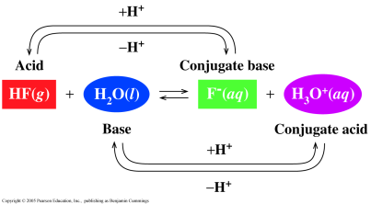
Conjugate Acid-Base Pairs
In the reaction of HF and H₂O,
HF/F⁻ is one conjugate acid-base pair.
H₂O/H₃O⁺ is the other conjugate acid-base pair.
Each pair is related by a loss and gain of H⁺.

Slide 17
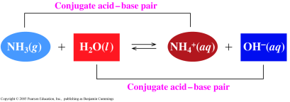
Conjugate Acid-Base Pairs
In the reaction of NH₃ and H₂O,
one conjugate acid-base pair is NH₃/NH₄⁺
the other conjugate acid-base is H₂O/H₃O⁺.

Slide 18
What is the conjugate base of:
H₂S
NH₄⁺
H₂CO₃
HS
B) HS⁺
S²⁻
HS⁻
NH₃⁻
B) NH₃
NH₃⁺
D) NH₂⁻
HCO₃⁻
B) CO₂
CO₃²⁻
HCO₂²⁻
AH A⁻ + H⁺
AH⁺ A + H⁺
AH⁻ A²⁻ + H⁺

Slide 19
Question:
What is the conjugate acid of:
NO₂⁻
NH²⁻
OH⁻
A) HNO₂⁺
B) HNO₂
C) HNO₂ ⁻
D) HNO₂²⁺
NH₂
B) NH₂⁻
NH₂⁺
D) NH₃⁺
H₂O⁺
B) H₂O⁻
H₃O⁺
H₂O
B⁻ + H⁺ BH
B + H⁺ BH⁺
B⁺ + H⁺ BH²⁺

Slide 20
Conjugate Acid-Base Pairs
Identify conjugate acid-base pairs in the following reactions:
NH₄⁺ + H₂O ⎯→ NH₃ + H₃O⁺
H₂S + NH₃ ⎯→ HS– + NH₄⁺
H₃PO₄ + H₂O ⎯→ H₂PO₄– + H₃O⁺
H₂O + HS– ⎯→ HO⁻ + H₂S
Water acts as an acid and a base!

Slide 21

Amphiprotic Species
Amphiprotic or amphoteric- species that can gain or lose a proton under the appropriate conditions
Acid
Base
Base
Acid
Water acts as an acid and a base!

Slide 22
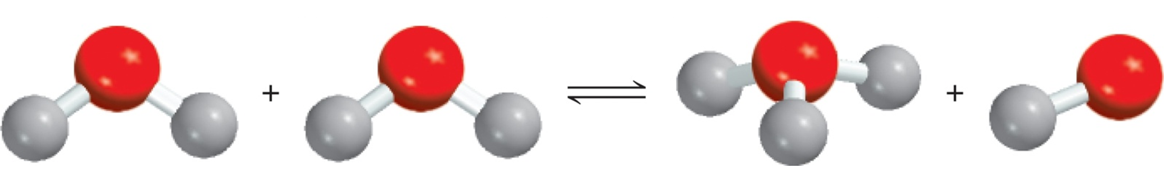
Water Acid-Base Reaction
-
[
]
+
H
O
+
H
O
H
O
H
+
H
O
H
H
H
acid
base
conjugate acid
conjugate base
H₂O + H₂O H₃O⁺ + OH⁻
H₃O⁺ ≈ H⁺
H₂O(l) H⁺(aq) + OH⁻(aq)

Slide 23
Autoionization of Water
Even very pure water exhibits a very small residual conductance. Water is a very weak electrolyte.
The dissociation of a pure liquid is known as autoionization (or self-ionization).
The dissociation is reversible.
H₂O_{(l)} H⁺_{(aq)} + OH⁻_{(aq)}
K_{c}
=
[H⁺][OH⁻]
= K_{w}
K_{w} is called the ion-product constant of water.
At 25⁰C
K_{w} = [H⁺][OH⁻] = 1.0 x 10⁻¹⁴

Slide 24
Acidic, Basic, and Neutral Solutions
K_{w} = [H⁺][OH⁻] = 1.0 x 10⁻¹⁴
In a neutral solution
In an acidic solution
In a basic solution
Note that at all times
[H⁺] = [OH⁻]
neutral
[H⁺] > [OH⁻]
acidic
[H⁺] < [OH⁻]
basic

Slide 25
The concentration of OH⁻ ions in a certain household ammonia cleaning solution is 0.0025 M. Calculate the concentration of H⁺ ions. Is the solution acidic or basic?
K_{w} = [H⁺][OH⁻] = 1.0 x 10⁻¹⁴
[OH⁻] = 0.0025 M
[H⁺] < [OH⁻]
The solution is basic.
But how basic?

Slide 26

CH 4, Review

Slide 27
pH Scale
pH = -log [H⁺]
Solution Is
At 25⁰C
neutral
[H⁺] = [OH⁻]
[H⁺] = 1.0 x 10⁻⁷
pH = 7
acidic
[H⁺] > [OH⁻]
[H⁺] > 1.0 x 10⁻⁷
pH < 7
basic
[H⁺] < [OH⁻]
[H⁺] < 1.0 x 10⁻⁷
pH > 7
pH
[H⁺]

Slide 28
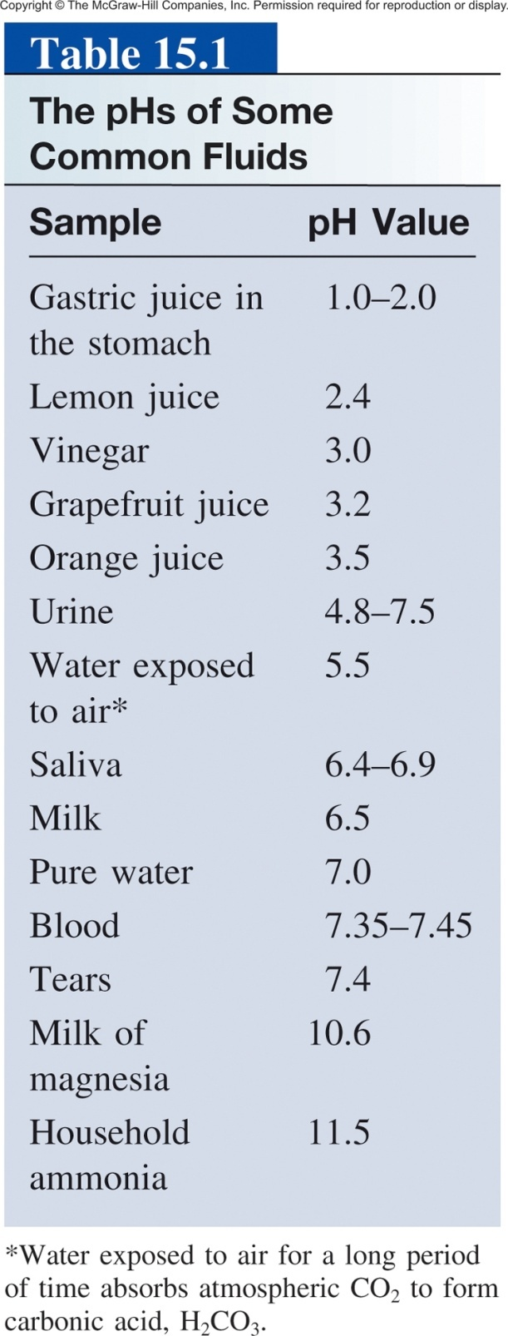
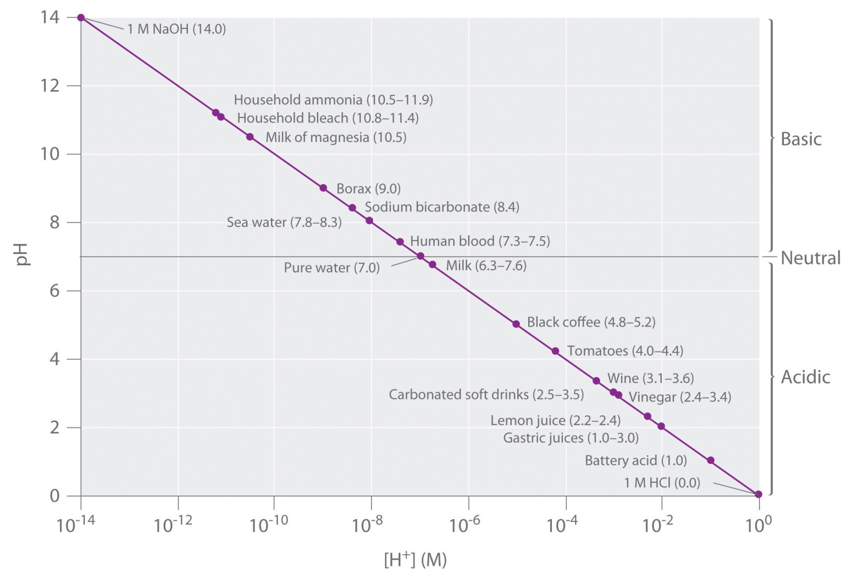
pH = -log [H⁺]

Slide 29
pOH Scale
In the analogy to the pH scale, we can define a pOH-scale for the concentration [OH–].
K_{w} = [H⁺][OH⁻] = 1.0 x 10⁻¹⁴
-log [H⁺] – log [OH⁻] = 14
pOH = -log [OH⁻]
pH + pOH = 14
It is important to remember that:
This relation is valid only at 25°C!
At other temperatures, the autoionization constant of water and, therefore, the (pH+pOH) are different.

Slide 30
Relevant Equations Summary
1) K_{w} = [H⁺][OH⁻] = 1.0 x 10⁻¹⁴
2) pH = -log [H⁺]
3) pOH = -log [OH]
4) pH + pOH = 14
If you know [H⁺],
you can calculate pH using equation 2.
you can calculate [OH-] using equation 1 (or 2+4+3)
you can calculate pOH using equation 1+3 (or 2+4)

Slide 31
The concentration of H⁺ ions in a bottle of table wine was
3.2 x 10⁻⁴ M right after the cork was removed. Only half of the wine was consumed. The other half, after it had been standing open to the air for a month, was found to have a hydrogen ion concentration equal to 1.0 x 10⁻³ M. Calculate the pH of the wine on these two occasions.
pH = -log [H⁺]
At time 0:
[H⁺] = 3.2 x 10⁻⁴ M
pH = -log (3.2 x 10⁻⁴) = 3.49
At time 1 month:
[H⁺] = 1.0 x 10⁻³ M
pH = -log (1.0 x 10⁻³ ) = 3.00

Slide 32
The pH of rainwater collected in a certain region of the northeastern United States on a particular day was 4.82. Calculate the H⁺ ion concentration of the rainwater.
What is the pOH?
pH = -log [H⁺]
4.82 = -log [H⁺]
-4.82 = log [H⁺]
10^{-4.82} = 10^{log [H+]}
1.5 x 10⁻⁵ M = [H⁺]
Experimental values are almost always reported in pH, not pOH!

Slide 33
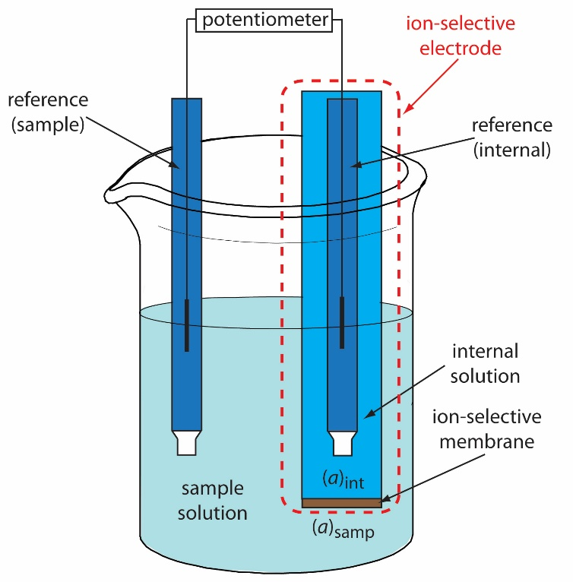
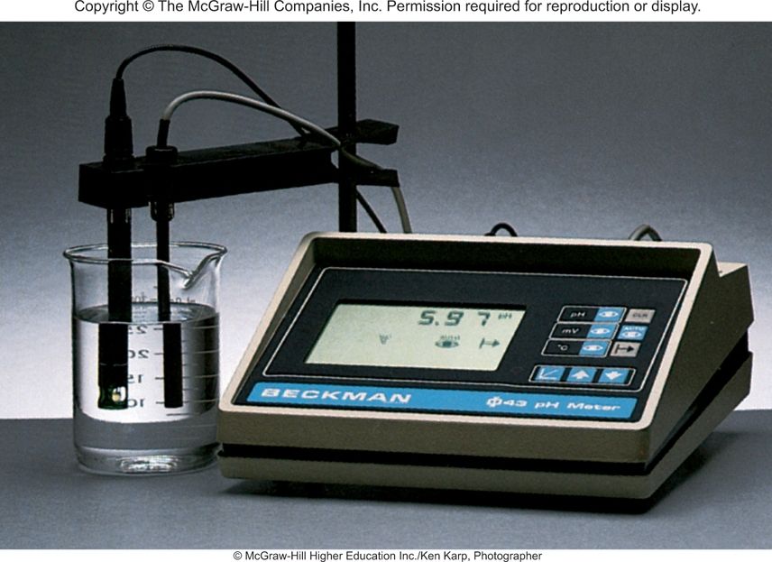
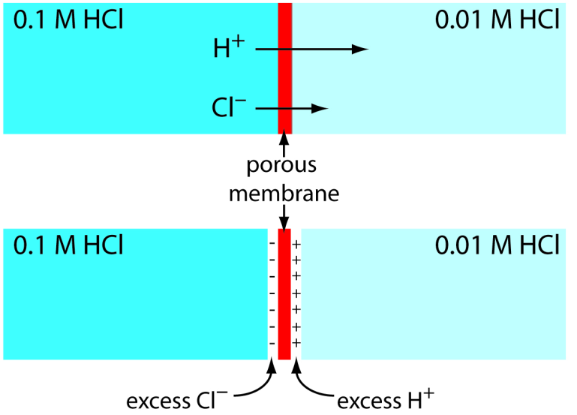
Why we use pH and not pOH
pH Meter

Slide 34
CH 4, Review
Strong vs. weak acids/bases
Acid dissociation constant (K_{a})
Base dissociation constant (K_{b})
K_{a} and K_{b}
Percent Ionization
Effect of Structure on Acidity/Basisity

Slide 35
Strong and Weak Acids
Acids can be either strong electrolytes or weak electrolytes.
Strong acids completely break up into their ions:
HCl (aq) → H⁺(aq) + Cl⁻(aq)
Weak acids only partially break up into their ions:
HC₂H₃O₂ ⬄ H⁺ (aq) + C₂H₃O₂⁻(aq)
Weak acids don’t completely dissociate, they go to equilibrium!
The extent of dissociation has a dramatic effect on the reactivity of acids.

Slide 36
Strong and Weak Acids
6 Strong acids:
  The hydrohalic acids (HCl, HBr, and HI).
  Oxoacids in which the number of O atoms exceeds the number of ionizable protons by two or more, for example, HNO₃, H₂SO₄, HClO₄.
Weak acids:
  Any H⁺ donor that is not those six.
  Hydrofluoric acid (HF).
  Oxoacids in which the number of O atoms equals or exceeds by one the number of ionizable protons, for example, HNO₂, H₂SO₃, H₄SiO₄.
  Acids in which H is not bonded to O or halogen, such as H₂S, HCN.
  Carboxylic acids, such as CH₃COOH, C₆H₅COOH.

Slide 37
Strong and Weak Acids
Strong Acids are strong electrolytes
HCl_{(aq)} H⁺_{(aq)} + Cl⁻_{(aq)}
HNO₃⁻_{(aq)} H⁺_{(aq)} + NO₃²⁻_{(aq)}
HClO_{4(aq)} H⁺_{(aq)} + ClO₄⁻_{(aq)}
H₂SO_{4(aq)} H⁺_{(aq)} + SO₄⁻_{(aq)}
Weak Acids are weak electrolytes
HF_{(aq)} H⁺_{(aq)} + F⁻_{(aq)}
HNO_{2(aq)} H⁺_{(aq)} + NO₂⁻_{(aq)}
HSO₄⁻_{(aq)} H⁺_{(aq)} + SO₄²⁻_{(aq)}
H₂O_{(l)} H⁺_{(aq)} + OH⁻_{(aq)}

Slide 38
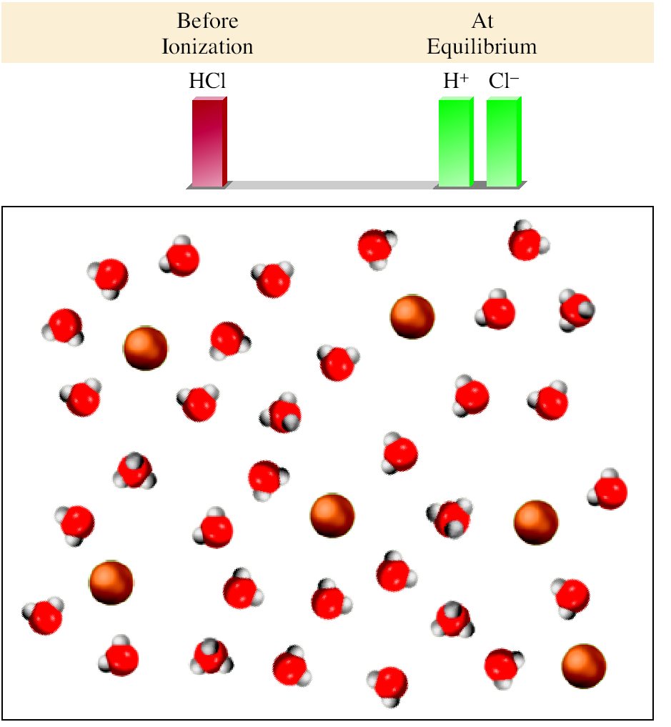
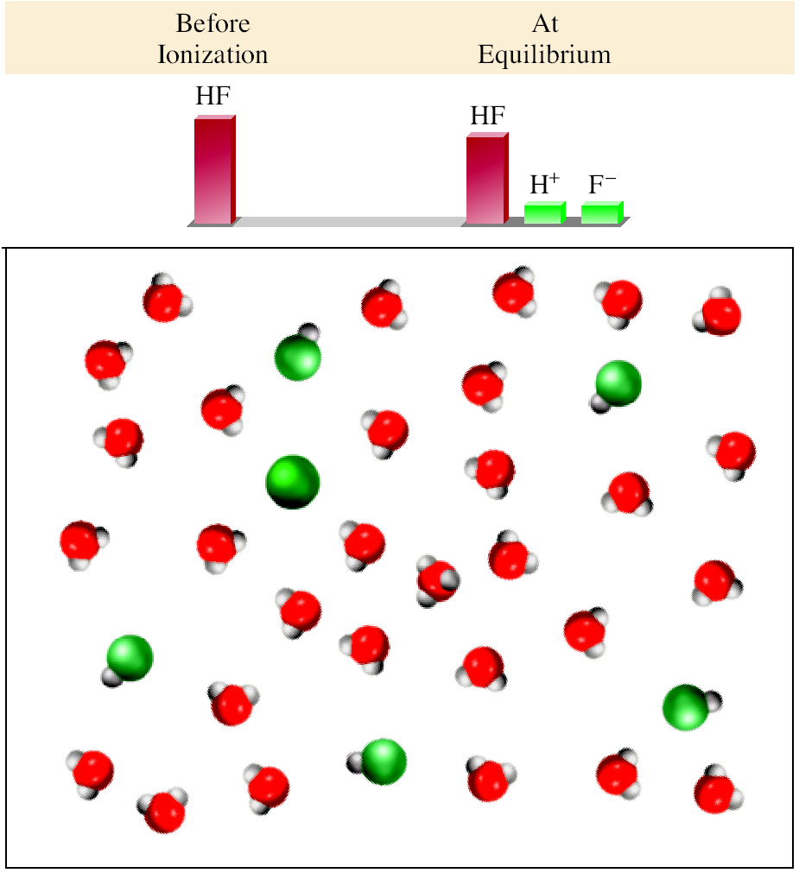
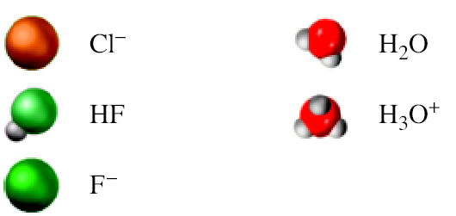
Strong Acid (HCl)
Weak Acid (HF)
HCl_{(aq)} H⁺_{(aq)} + Cl⁻_{(aq)}
HF_{(aq)} H⁺_{(aq)} + F⁻_{(aq)}
HCl_{(aq)} + H₂O_{(l)} H₃O⁺_{(aq)} + Cl⁻_{(aq)}
HF_{(aq)} + H₂O_{(l)} H₃O⁺_{(aq)} + F⁻_{(aq)}

Slide 39
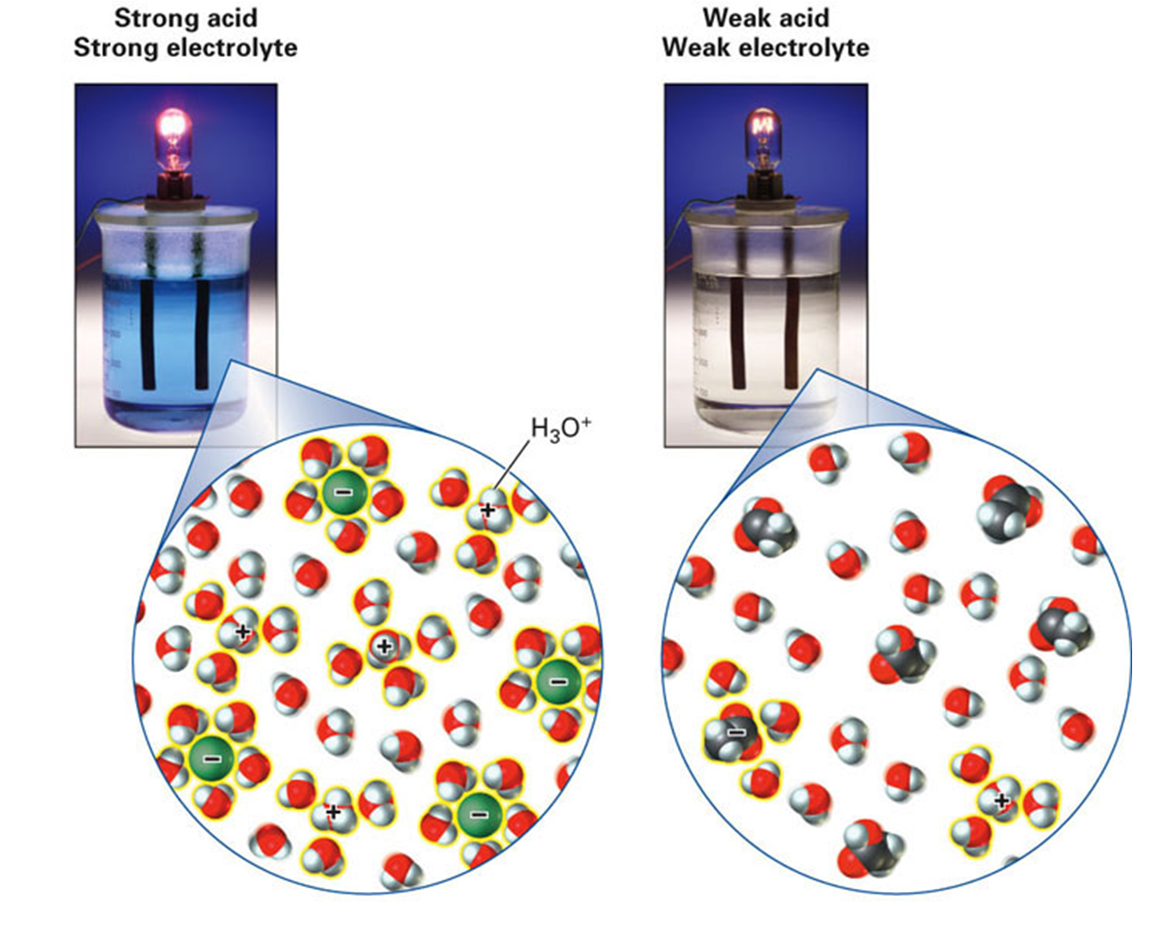
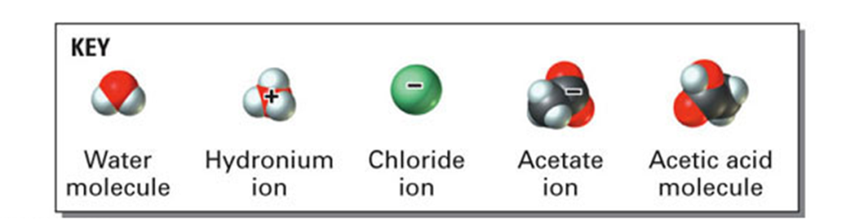
HCl_{(aq)} H⁺_{(aq)} + Cl⁻_{(aq)}
AcOH_{(aq)} H⁺_{(aq)} + AcO⁻_{(aq)}

Slide 40
Strong and Weak Bases
Bases can be either strong electrolytes or weak electrolytes.
Strong bases completely break up into their ions:
NaOH (aq) → Na⁺(aq) + OH⁻(aq)
Weak bases only partially break up into their ions:
NH₃ (aq) + H₂O(l) ⬄ NH₄⁺ (aq) + OH⁻(aq)
Weak bases don’t completely dissociate, they go to equilibrium!
The extent of dissociation has a dramatic effect on the reactivity of bases.

Slide 41
Strong and Weak Bases
6 Strong bases:
  MOH, where M = Na, K, Li.
  M(OH)₂, where M = Ca, Sr, Ba.
Weak bases:
  Any H⁺ acceptor that is not those six.
  Other metal hydroxides, Mg(OH)₂, Zn(OH)₂, Co(OH)₂, La(OH)₃.
  Ammonia (NH₃).
  Amines, such as CH₃NH₂, (CH₃)₂NH, C₅H₅N.

Slide 42
Strong and Weak Bases
Strong Bases are strong electrolytes
NaOH_{(s)} Na⁺_{(aq)} + OH⁻_{(aq)}
KOH_{(s)} K⁺_{(aq)} + OH⁻_{(aq)}
Ba(OH)_{2(s)} Ba²⁺_{(aq)} + 2OH⁻_{(aq)}
Weak Bases are weak electrolytes
NH_{3(aq)} + H₂O_{(l)} NH₄⁺_{(aq)} + OH⁻_{(aq)}
C₅H₅N_{(aq)} + H₂O_{(l)} C₅H₅NH⁺_{(aq)} + OH⁻_{(aq)}
CO₃²⁻_{(aq)} + H₂O_{(l)} CO₃H⁻_{(aq)} + OH⁻_{(aq)}

Slide 43
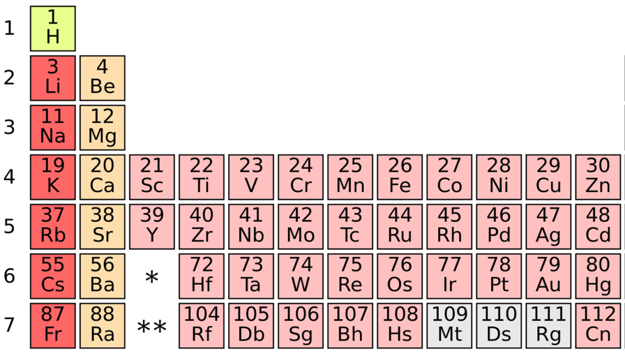
Strong and Weak Acids/Bases
Strong Acids
HClO₄
H₂SO₄
HI
HBr
HCl
HNO₃
Strong Bases
Hydroxides of group 1 and 2
metals: M(OH)_{1 or 2}
(excluding Be, Mg, Rb, Cs)
Everything else that is a proton donor or acceptor is a weak acid/base.

Slide 44
pH = -log [H⁺]
pOH = -log [OH]
Calculate the pH of a
1.0 x 10⁻³ M HCl solution
pH + pOH = 14
?
Strong or weak acid?
  HCl_{(aq)} H⁺_{(aq)} + Cl⁻_{(aq)}
1.0 x 10⁻³ M
1.0 x 10⁻³ M
pH = -log (1.0 x 10⁻³)
pH = 3.00
(b) 0.020 M Ba(OH)₂ solution
?
Strong or weak base?
  Ba(OH)_{2(aq)} 2OH⁻_{(aq)} + Ba₂⁺_{(aq)}
0.02 M
0.04 M
[OH⁻] = 0.040 M
pOH = -log 0.040 = 1.40
pH = 14.00 – pOH = 12.60

Slide 45
Relative Strength of Acid-Base Pairs
AH + B⁻ A⁻ + BH
acid
base
conjugate base
conjugate acid
Acids/Bases Conjugate Bases/acids
Very Strong Very Weak
Strong Weak
Weak Strong
Very Weak Very Strong
_______________________________________
Strong acids lose protons readily ➔ weak conjugate bases;
Weak acids do not lose protons readily ➔ strong conjugate bases.

Slide 46
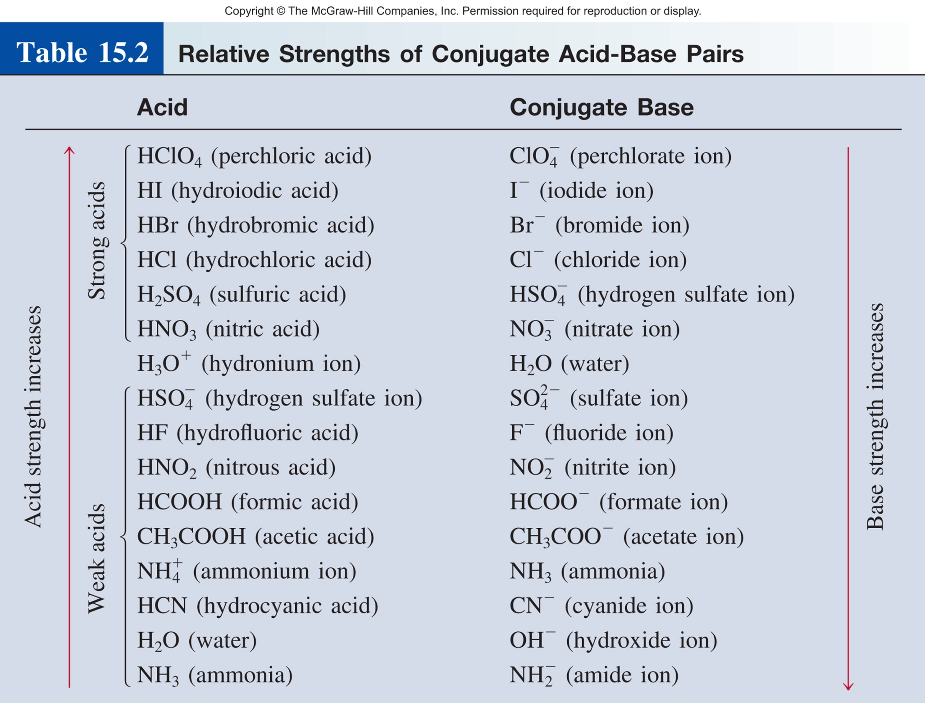
Knowing relative strength allows us to:
Directly calc the pH of solution (if it is a strong acid/base).
Predict if the equilibrium will favor reactants or products.

Slide 47
CH 4, Review
Strong vs. weak acids/bases
Acid dissociation constant (K_{a})
Base dissociation constant (K_{b})
K_{a} and K_{b}
Percent Ionization
Effect of Structure on Acidity/Basisity

Slide 48
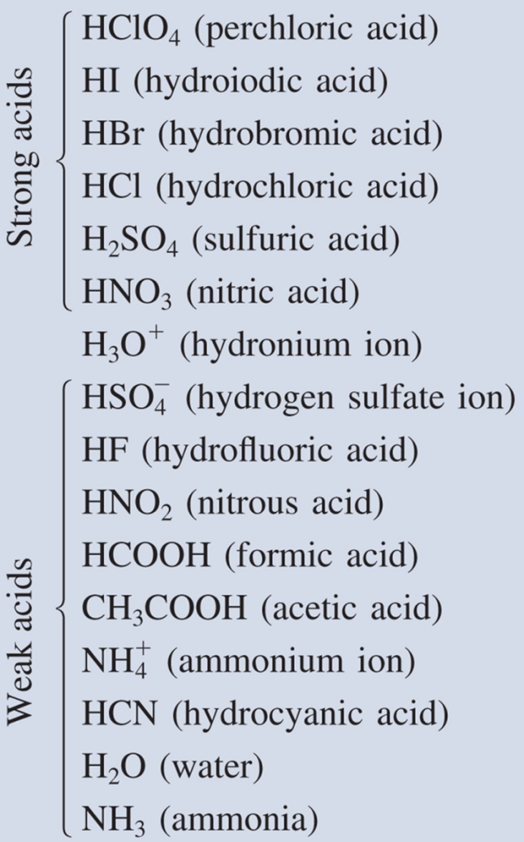
Acids: How Strong? How Weak?
Relative scale is not particularly useful.
Qualitative, not quantitative.
There has to be a better way!
HA (aq) H⁺ (aq) + A⁻ (aq)
Since the system is at equilibrium, we can write an equilibrium expression.
[H⁺][A⁻]
K_{a} =
[HA]
K_{a} is the acid ionization constant

Slide 49
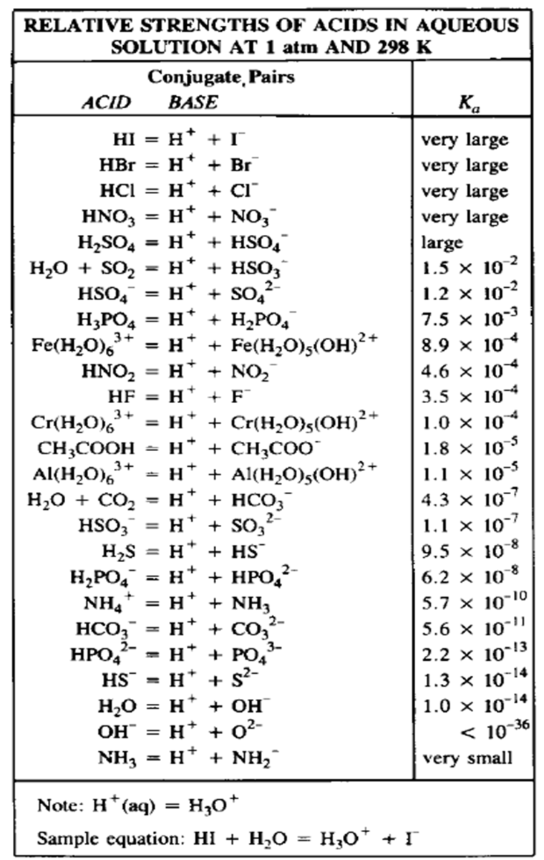
Acids: How Strong? How Weak?
[H⁺][A⁻]
K_{a} =
[HA]
K_{a} is the acid ionization constant
HA (aq) H⁺ (aq) + A⁻ (aq)
Stronger,
Large K_{a}
Weaker acid,
Smaller K_{a}
The value of K_{a} is very large for strong acids and moderate or small for weak acids.
acid
strength
K_{a}

Slide 50
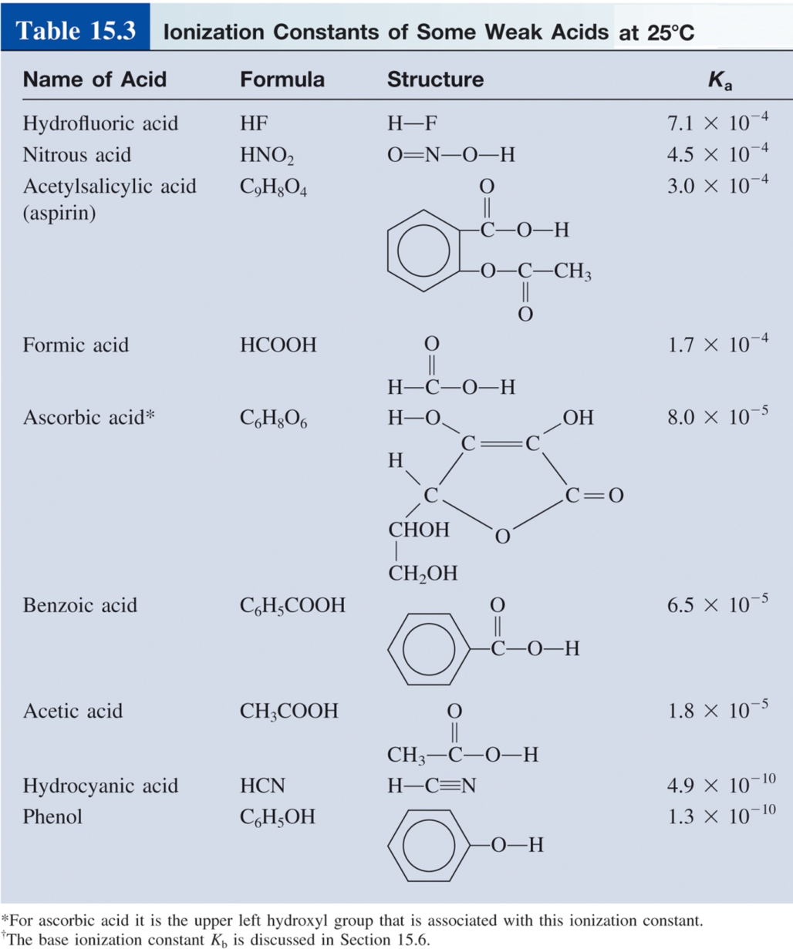

Slide 51
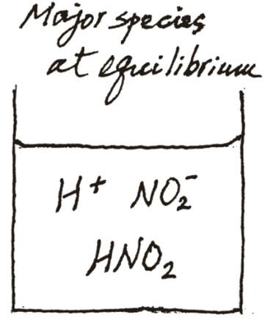
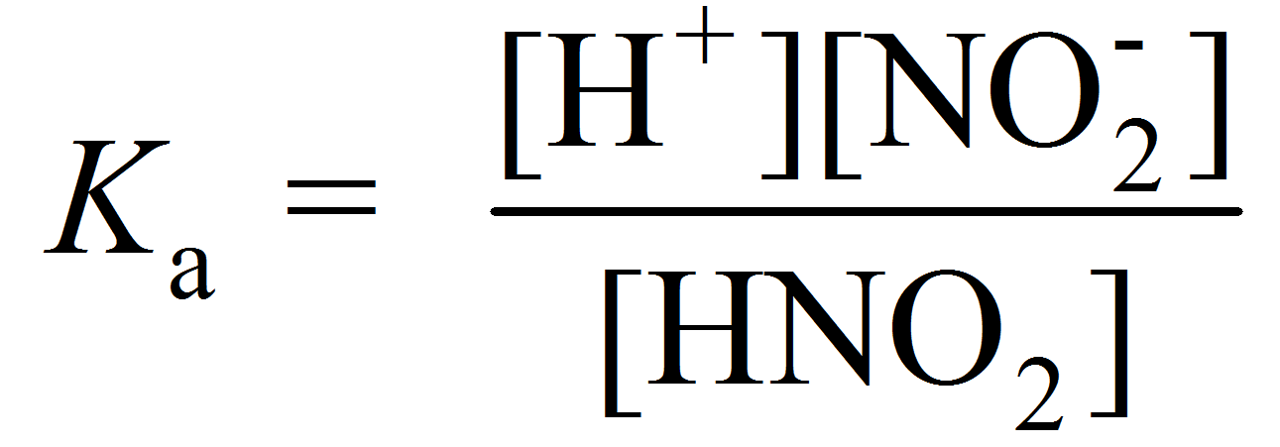
Calculate the pH of a 0.036 M HNO₂ (K_{a} = 4.5 x 10⁻⁴) solution:
HNO_{2(aq)} H⁺_{(aq)} + NO₂⁻_{(aq)}
Strong or weak acid?
[HNO₂] = 0.036 M
 | HNO₂(aq) |  | H⁺(aq) + | (aq)
Initial (M):
Change (M):
Equilibrium (M):
0.036
0.00
0.00
-x
+x
+x
0.036 - x
x
x

Slide 52
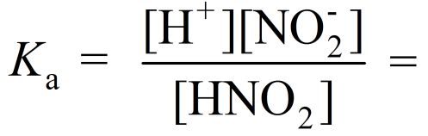
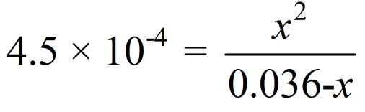
 | HNO₂(aq) |  | H⁺(aq) + | (aq)
Initial (M):
Change (M):
Equilibrium (M):
0.036
0.00
0.00
-x
+x
+x
0.036 - x
x
x
[H⁺] = 3.8 x 10⁻³ M
pH = -log (3.8 x 10⁻³ )
= 2.42

Slide 53
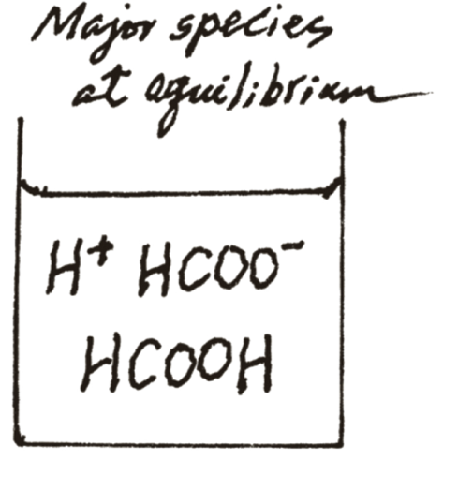
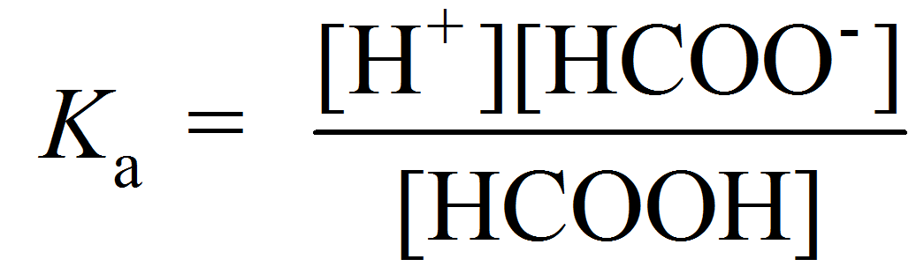
The pH of a 0.10 M solution of formic acid (HCOOH) is 2.39. What is the K_{a} of the acid?
Strong or weak acid?
HCOOH_{(aq)} H⁺_{(aq)} + HCOO⁻_{(aq)}
[HCOOH]₀ = 0.10 M
pH = 2.39
K_{a} = ?

Slide 54
The pH of a 0.10 M solution of formic acid (HCOOH) is 2.39. What is the K_{a} of the acid?
HCOOH_{(aq)} H⁺_{(aq)} + HCOO⁻_{(aq)}
[HCOOH]₀ = 0.10 M
K_{a} = ?
pH = 2.39
 | HCOOH(aq) |  | H⁺(aq) + | HCOO⁻(aq)
Initial (M):
Change (M):
Equilibrium (M):
0.10
0.00
0.00
- 4.1 x 10⁻³
+ 4.1 x 10⁻³
+ 4.1 x 10⁻³
(0.10 - 4.1 x 10⁻³)
4.1 x 10⁻³
4.1 x 10⁻³
pH = -log [H⁺]
2.39 = -log [H⁺]
[H⁺] = 4.1 x 10⁻³ M

Slide 55
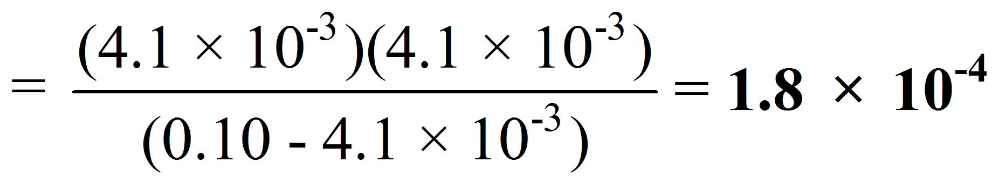
The pH of a 0.10 M solution of formic acid (HCOOH) is 2.39. What is the K_{a} of the acid?
HCOOH_{(aq)} H⁺_{(aq)} + HCOO⁻_{(aq)}
 | HCOOH(aq) |  | H⁺(aq) + | HCOO⁻(aq)
Initial (M):
Change (M):
Equilibrium (M):
0.10
0.00
0.00
- 4.1 x 10⁻³
+ 4.1 x 10⁻³
+ 4.1 x 10⁻³
(0.10 - 4.1 x 10⁻³)
4.1 x 10⁻³
4.1 x 10⁻³

Slide 56
CH 4, Review
Strong vs. weak acids/bases
Acid dissociation constant (K_{a})
Base dissociation constant (K_{b})
K_{a} and K_{b}
Percent Ionization
Effect of Structure on Acidity/Basisity

Slide 57
Bases: How Strong? How Weak?
B⁻(aq) + H₂O(l) BH(aq) + OH⁻(aq)
Since the system is at equilibrium, we can write an equilibrium expression.
[BH][OH⁻]
K_{b} =
[B⁻]
K_{b} is the base ionization constant

Slide 58
Bases: How Strong? How Weak?
[BH][OH⁻]
K_{b} =
[B⁻]
K_{b} is the base ionization constant
B⁻(aq) + H₂O(l) BH(aq) + OH⁻(aq)
Strong base,
Larger K_{b}
Weaker base,
Smaller K_{b}
base
strength
K_{b}

Slide 59
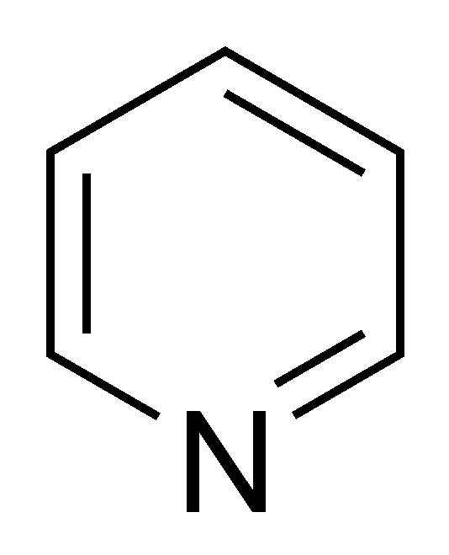
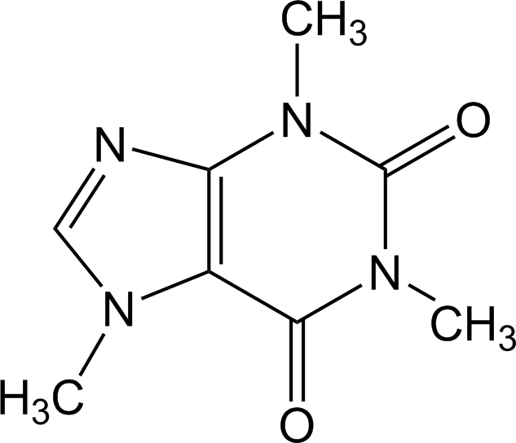

Bases: How Strong? How Weak?
Base | Formula | K_{b} | Conj. Acid
Ethylamine | C₂H₅NH₂ | 5.6×10⁻⁴ | C₂H₅NH₃⁺
Methylamine | CH₃NH₂ | 4.4×10⁻⁴ | CH₃NH₃⁺
Ammonia | NH₃ | 1.8×10⁻⁵ | NH₄⁺
Pyridine |  | 1.7×10⁻⁹ | C₅H₅NH⁺
Aniline | C₆H₅NH₂ | 3.8×10⁻¹⁰ | C₆H₅NH₃⁺
Caffeine |  | 5.3×10⁻¹⁴
  Base strength
H
⁺
Solve weak base problems like weak acids except solve for [OH⁻] instead of [H⁺].

Slide 60
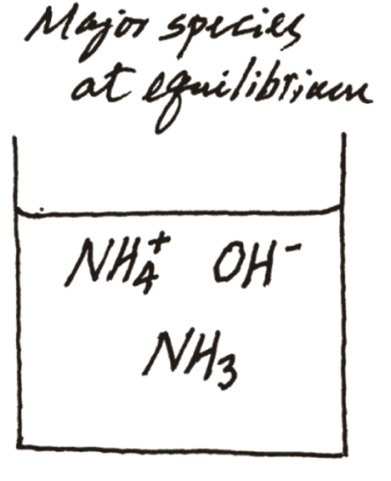
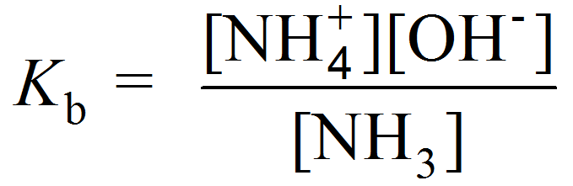
What is the pH of a 0.40 M NH₃ solution (K_{b} = 1.8×10⁻⁵)?
NH₃(aq) + H₂O(l) NH₄⁺(aq) + OH⁻(aq)
K_{b} = 1.8×10⁻⁵
[NH₃]₀ = 0.40 M
pH = ?
We have the information to find OH.
We can use OH to find pH.

Slide 61
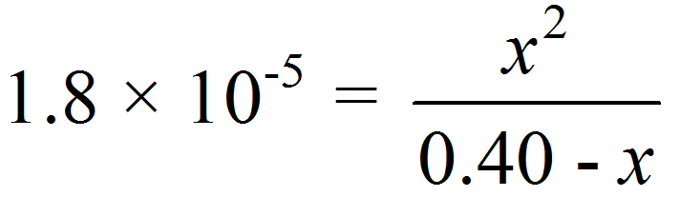
What is the pH of a 0.40 M NH₃ solution (K_{b} = 1.8×10⁻⁵)?
Find OH⁻
NH₃(aq) + H₂O(l) NH₄⁺(aq) + OH⁻(aq)
K_{b} = 1.8×10⁻⁵
[NH₃]₀ = 0.40 M
 | NH₃(aq) | + H₂O (l) |  | (aq) | + OH⁻(aq)
Initial (M):
Change (M):
Equilibrium (M):
0.40
0.00
0.00
-x
+x
+x
0.40 - x
x
x
but…
[NH₃]₀
K_{b}
If > 400
we can neglect x

Slide 62
What is the pH of a 0.40 M NH₃ solution (K_{b} = 1.8×10⁻⁵)?
Find OH⁻
NH₃(aq) + H₂O(l) NH₄⁺(aq) + OH⁻(aq)
K_{b} = 1.8×10⁻⁵
[NH₃]₀ = 0.40 M
 | NH₃(aq) | + H₂O (l) |  | (aq) | + OH⁻(aq)
Initial (M):
Change (M):
Equilibrium (M):
0.40
0.00
0.00
-x
+x
+x
0.40 - x
x
x
[OH⁻] = 2.7 x 10⁻³ M

Slide 63
What is the pH of a 0.40 M NH₃ solution (K_{b} = 1.8×10⁻⁵)?
Find pH
NH₃(aq) + H₂O(l) NH₄⁺(aq) + OH⁻(aq)
[OH⁻] = 2.7 x 10⁻³ M
pH + pOH = 14
pOH = -log (2.7 x 10⁻³ ) = 2.57
pH + pOH = 14.00
pH + 2.57 = 14.00
pH = 11.43

Slide 64
CH 4, Review
Strong vs. weak acids/bases
Acid dissociation constant (K_{a})
Base dissociation constant (K_{b})
K_{a} and K_{b}
Percent Ionization
Effect of Structure on Acidity/Basisity

Slide 65
K_{a} and K_{b}
HA_{(aq)} H⁺_{(aq)} + A⁻_{(aq)}
A⁻(aq) + H₂O(l) AH(aq) + OH⁻(aq)
[H⁺][A⁻]
[AH][OH⁻]
K_{a} =
K_{b} =
[HA]
[A⁻]
For a acid-base conjugate pair in water:
HA (aq) H⁺ (aq) + A⁻ (aq)
K_{a}
A⁻ (aq) + H₂O (l) OH⁻ (aq) + HA (aq)
K_{b}
H₂O (l) H⁺ (aq) + OH⁻ (aq)
K_{w}
K_{a}K_{b} = K_{w}

Slide 66
K_{w}, K_{a} and K_{b} Summary
[H⁺][A⁻]
[AH][OH⁻]
K_{w} =
[H⁺][OH⁻]
K_{a} =
K_{b} =
[HA]
[A⁻]
K_{w} = 1 x 10⁻¹⁴
Weak Acid and Its Conjugate Base
K_{a}K_{b} = K_{w}
K_{w}
K_{w}
K_{a} =
K_{b} =
K_{b}
K_{a}

Slide 67
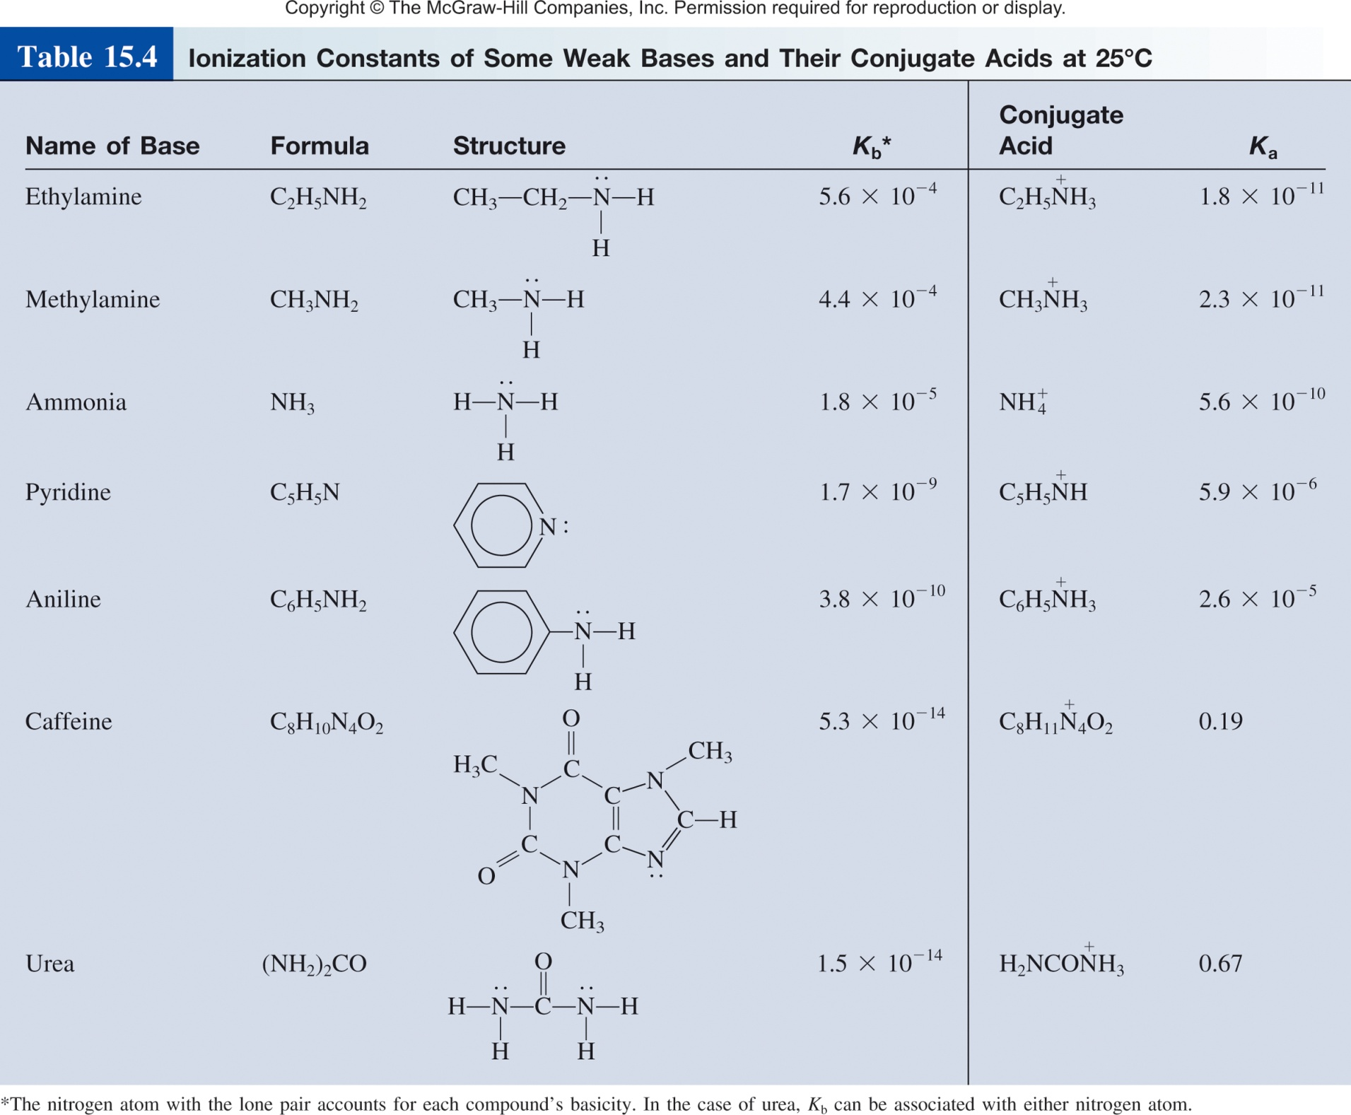

Slide 68
The K_{a} for formic acid (HCOOH) is 1.7x10⁻⁴. What is K_{b} for HCOO⁻?
K_{a}K_{b} = K_{w}

Slide 69
CH 4, Review
Strong vs. weak acids/bases
Acid dissociation constant (K_{a})
Base dissociation constant (K_{b})
K_{a} and K_{b}
Percent Ionization
Effect of Structure on Acidity/Basisity

Slide 70
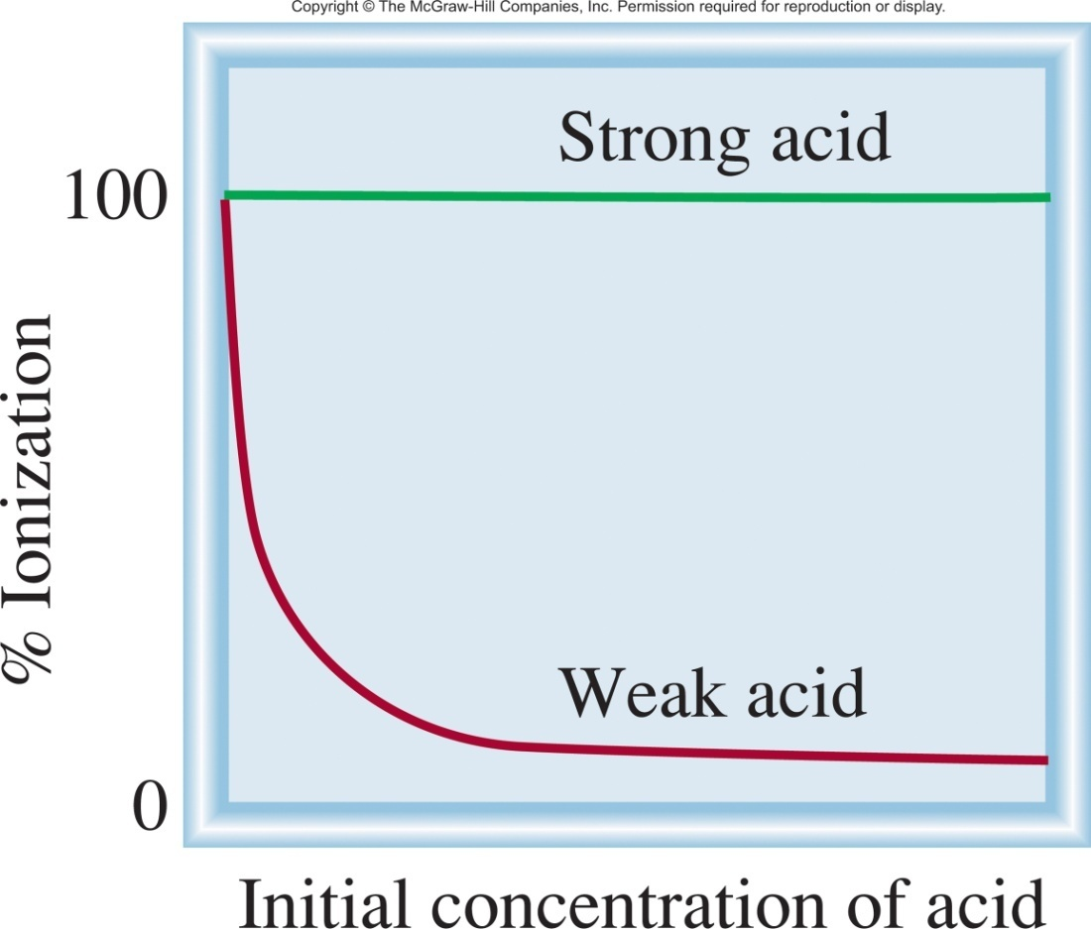
Alternative Notation
HA_{(aq)} H⁺_{(aq)} + A⁻_{(aq)}
acid ionization constant
percent ionization =
[H⁺][A⁻]
[H⁺] at equilibrium
K_{a} =
x 100%
[HA]
Initial concentration of [HA]
acid
strength
K_{a}
[H⁺]
Percent ionization =
x 100%
[HA]₀
Percent ionization:
Strong acids- % ionization is always 100%
Weak acids- % ionization decreases as concentration increases.

Slide 71
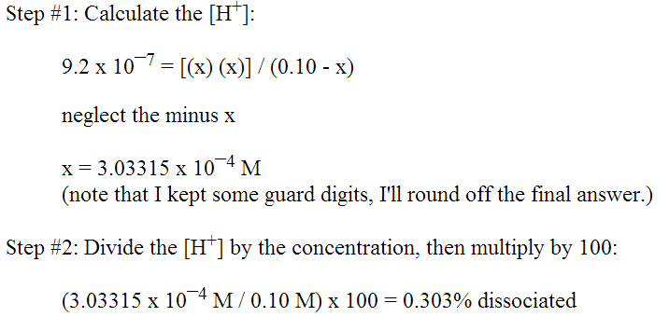
Percent Ionization
A certain weak acid, HA , has a K_{a} value of 9.2 x 10¯⁷
1) Calculate the percent ionization of HA in a 0.10 M solution.
2) Calculate the percent ionization of HA in a 0.010 M solution.
3) Calculate the percent ionization of HA in a 0.0010 M solution.
Question 1:
Question 2:
Question 3:
[HA]
% ion
% ionization change with concentration . K_{a} stays the same!

Slide 72
CH 4, Review
Strong vs. weak acids/bases
Acid dissociation constant (K_{a})
Base dissociation constant (K_{b})
K_{a} and K_{b}
Percent Ionization
Effect of Structure on Acidity/Basisity

Slide 73
Acid/Base Strength
Some factors that influence acid/base strength (K_{a}/K_{b}).
Temperature
Solvent
Acid Structure
  Hydrohalic acids
  Oxoacids
  Carboxylic acids
[H⁺][A⁻]
k_{fwd}
K_{a} =
=
[HA]
k_{rev}

Slide 74
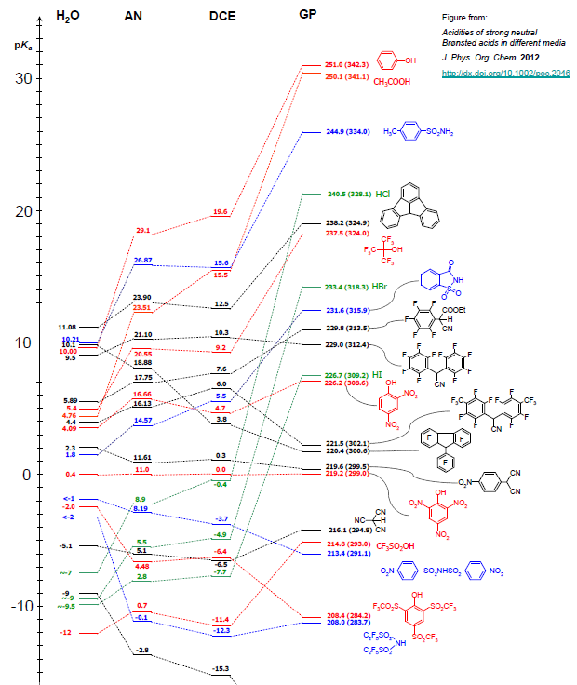
Solvent Dependence
HA (aq) H⁺ (aq) + A⁻ (aq)
[H⁺][A⁻]
K_{a} =
[HA]
H₂O =
AN =
DCE =
GP = Gas Phase

Slide 75
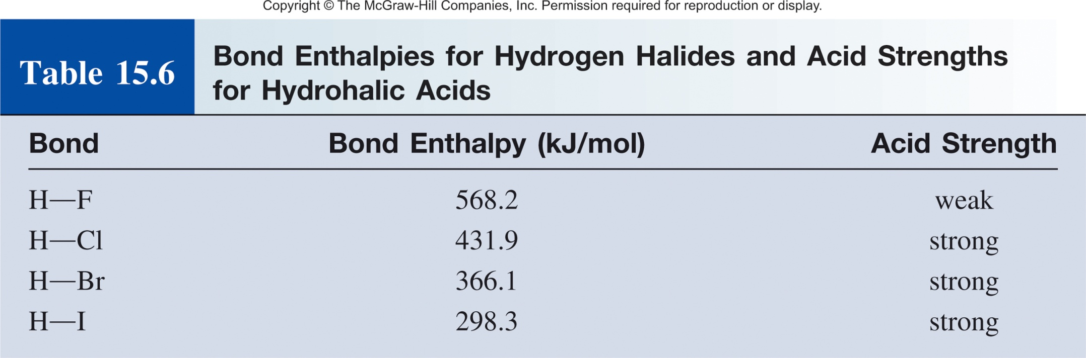
Hydrohalic Acid Strength
  The strength of an acid depends on the strength of the X–H bond that is to be broken.
Relative bond strength:
H─F > H─Cl > H─Br > H─I
Relative acid strength:
H─F < H─Cl < H─Br < H─I
For H-X, electronegativity does not play a big role.
K_{a}
7.2 x 10⁻⁴
~10⁷
~10⁹
~10⁹

Slide 76
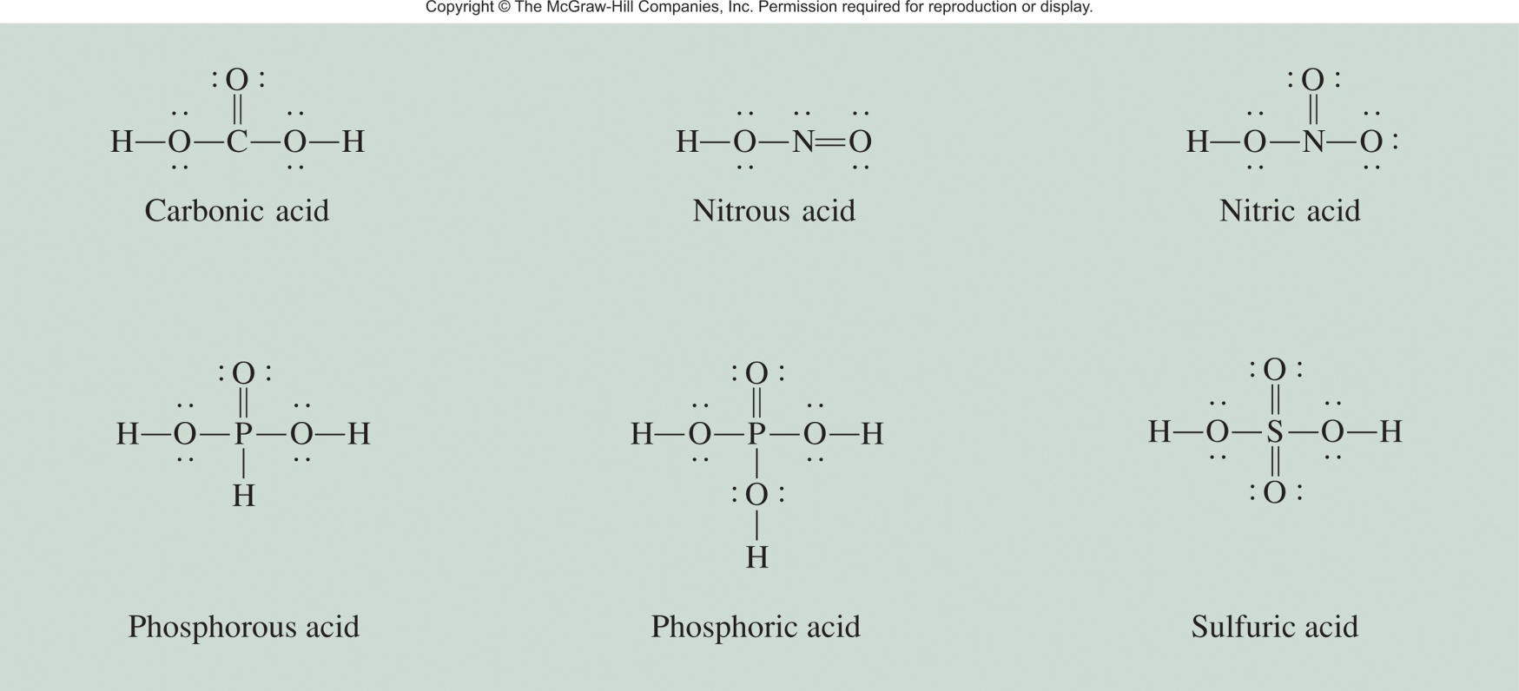
Oxoacid Strength
Oxoacids is an acid that contains oxygen and a central atom Z.
δ⁻
δ⁺
Z
O
H
Z
O⁻
+ H⁺
The O-H bond strength/K_{a} are dependent on:
electronegativity of Z
oxidation state of Z

Slide 77
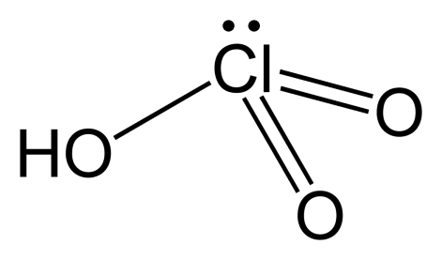

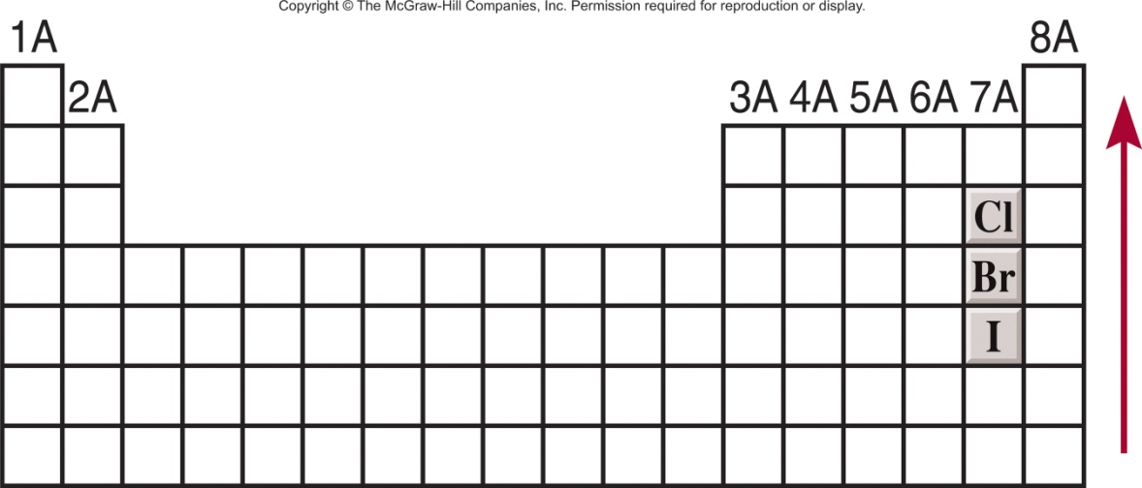
Oxoacid Strength
Oxoacids is an acid that contains oxygen and a central atom Z.
If they are from the same group and have the same oxidation number, acid strength increases with increasing electronegativity of Z.
Cl is more electronegative than Br
HClO₃ > HBrO₃
acidity
increases

Slide 78
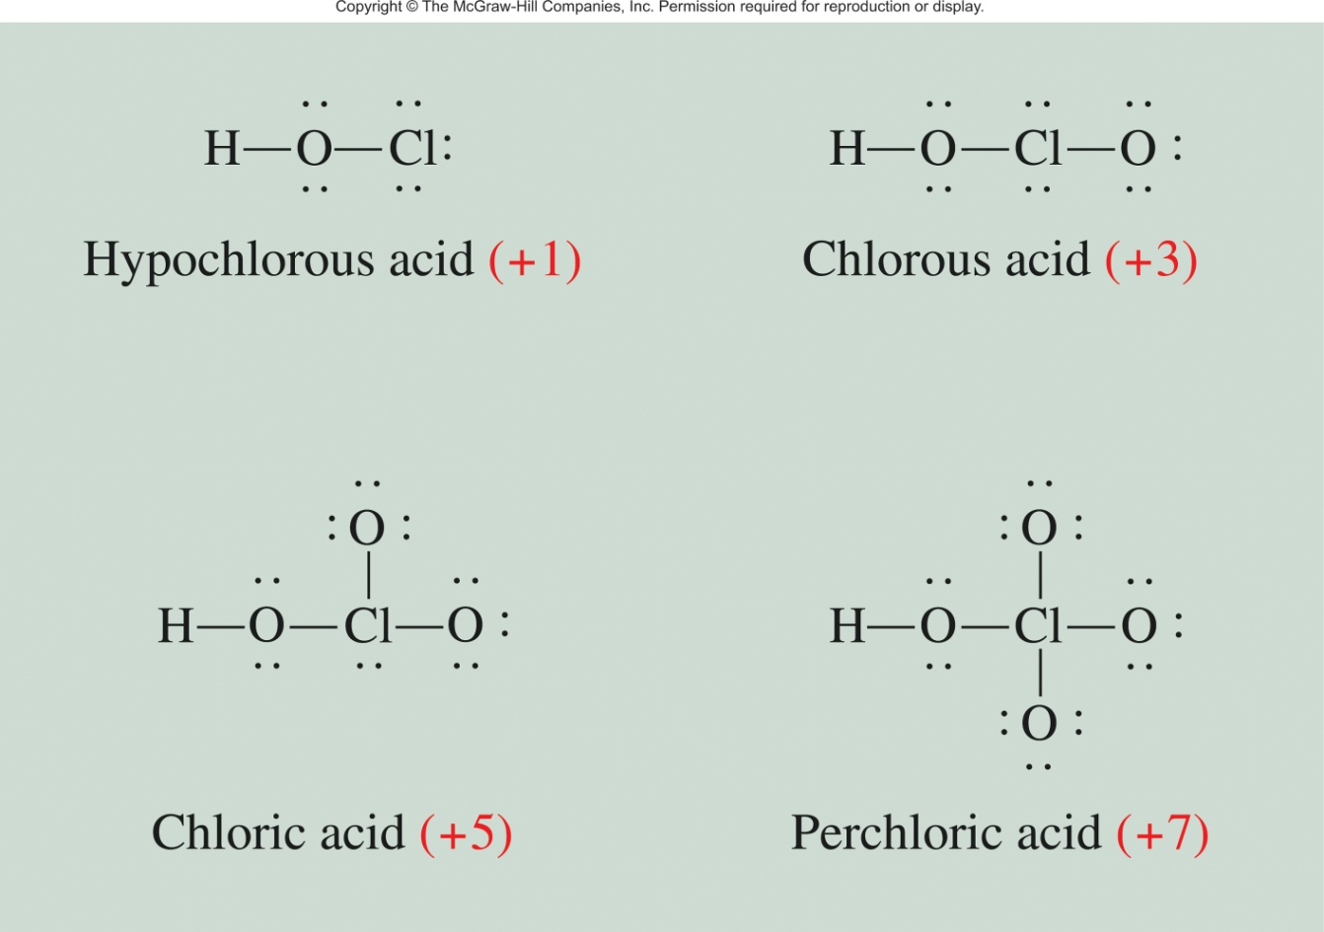
Oxoacid Strength
Oxoacids having the same central atom (Z) but different numbers of attached groups.
Acid strength increases as the oxidation number of Z increases.
HClO₄ > HClO₃ > HClO₂ > HClO

Slide 79

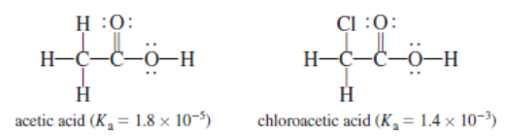
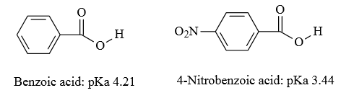

Carboxylic Acid Strength
General structure for a carboxylic acid:
Where R can be anything: H, CH₃, Ph, Cl…
The more electrongative R is the stronger the carboxylic acid.
Proximity of the electrongative atom matters.

Slide 80


Question:
What is the strongest acid:
BrOH
ClOH
IOH
A
B
C
A
B
CH₃OH
CBr₃OH
CF₃OH
A
B
C

Slide 81
CH 4, Review
Strong vs. weak acids/bases
Acid dissociation constant (K_{a})
Base dissociation constant (K_{b})
K_{a} and K_{b}
Percent Ionization
Effect of Structure on Acidity/Basisity

